Slide 1
Team game
By group 8
Notes:
J

Slide 2
initial ideas.
We had 2 ideas
How to act in lectures
Star Wars
Notes:
j

Slide 3
What our game is about.
The aim of the game is to find princess leia who has been kidnapped by Darth Vader.
In this journey you will encounter various locations from the star wars lore and you will be greeted with many obstacles during your journey.
Notes:
j

Slide 4
Why we chose to make a game about star wars
We chose a Star Wars themed game because it was a series we were all familiar with and we knew it would have mass appeal to Computer Science students.
Star wars is also filled with in depth lore that we can use to make the game interesting.
STATS
Notes:
j

Slide 5
Title sequence
The game includes the iconic title sequence in order to immediately immerse the gamer into the game.
Notes:
e

Slide 6
Story.
Play as Luke Skywalker or Han Solo.
The story is slightly different for each character at the start of the game to add replay ability to the game.
Luke Skywalker starts at his uncle’s farm
Han Solo starts at the bar.
However, the characters will meet up later on and fight against the evil empire.
Notes:
e

Slide 7
maps
Notes:
e

Slide 8
Characters- Heroes.
Each hero has different items, story lines and weapons.
This allows the game to be played more than once which is valued in video games.
Notes:
e

Slide 9
Characters- NPC’s.
Famous Star Wars characters appear as npc’s
One of the npc’s is Chewbacca which will an interesting message when you interact with him!
Notes:
l

Slide 10
Characters- Villains.
Various villains which will make the game more interesting an harder to complete.
These villains will have their own weapons and will deal damage according to their levels.
This stops the battles from feeling repetitive and boring.
Notes:
l

Slide 11
The beginnings of our game.
We used the template from our assessment 4 and 6 to create and expand on our game.
We also researched and added different functions that enable the game to become more immersive and all around fun to play.
Notes:
l

Slide 12
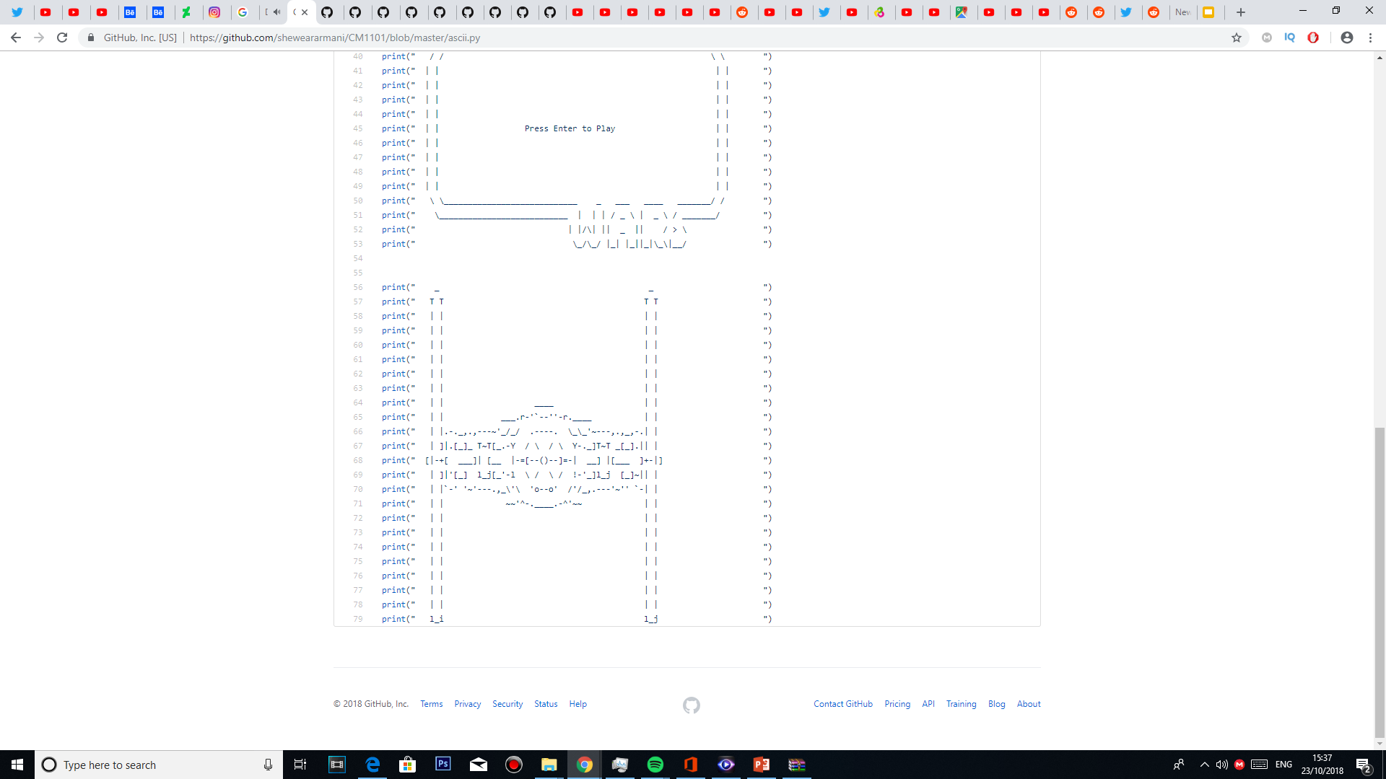
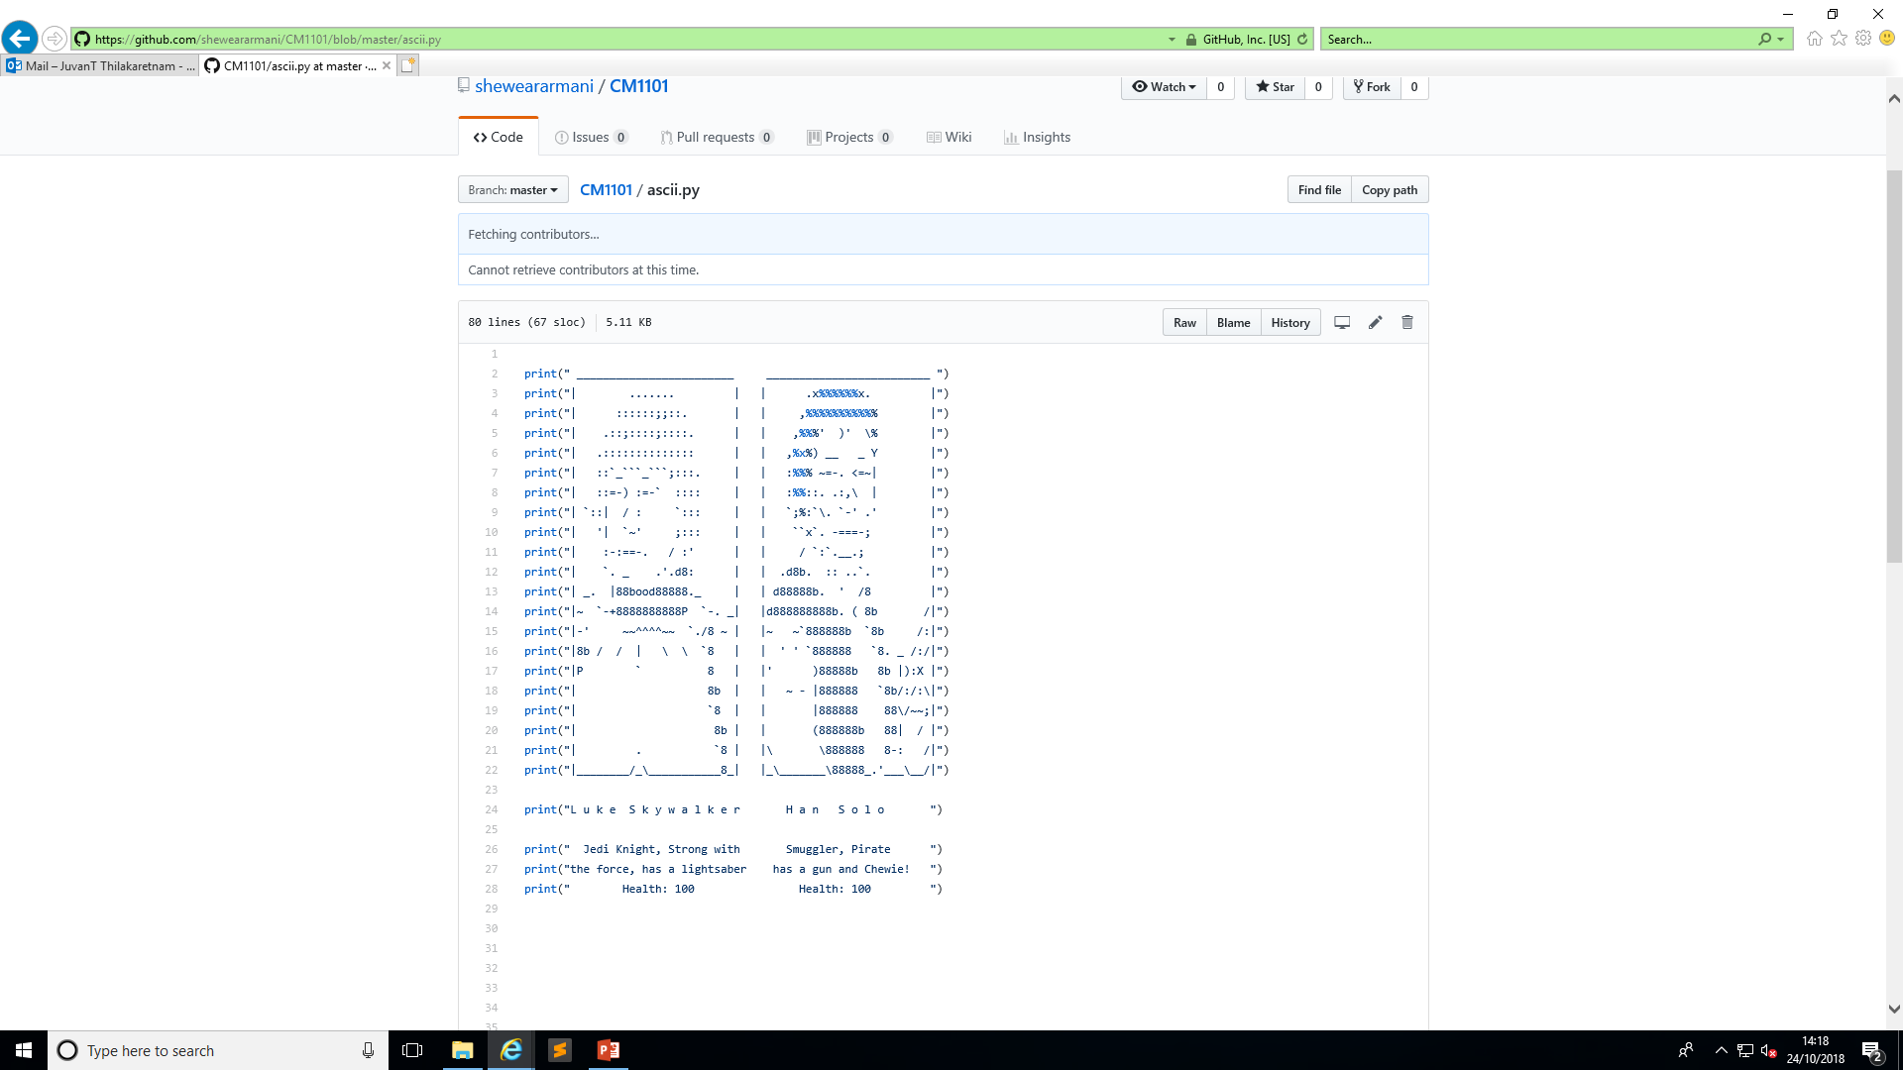
The beginnings of our game.
Usage of ascii art to make the game more interactive
Notes:
l

Slide 13
music
Music plays a big role in our game as it creates atmosphere and adds another level of depth.
We use a consistent amount of music throughout the game.
Notes:
o

Slide 14
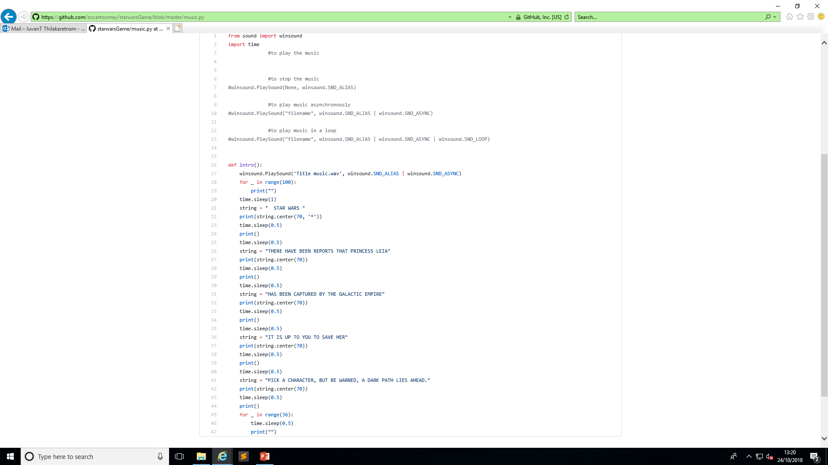
Notes:
o

Slide 15
Items.py
We’ve weapons, lightsaber,
Leia as an item
Notes:
o

Slide 16
map.py
Notes:
o

Slide 17
The beginnings of our game
Intricate descriptions for each character’s locations and the items around them.
This will make the game world feel real and will paint a picture of it in the gamer’s mind.
Notes:
c

Slide 18
Gameplay
Genre: RPG.
Our world is filled with many rooms and choices to make.
You could even go to places which don’t add to the main story lines but are used for comedic value to make your experience fresh and enjoyable.
Notes:
c

Slide 19
functions
We have researched and implemented a few functions into our game.
These include the shoot and equip functions that will be very crucial in completing the game.
Notes:
c

Slide 20
Battle system
We implemented a battle system that echo’s rpg system.
You deal damage by typing a particular word certain amount of times.
Right: damage to the enemy
Wrong: the enemy damages you.
Notes:
k

Slide 21
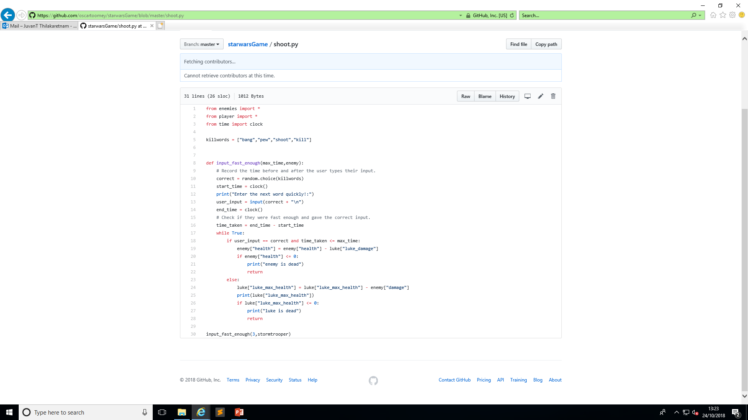
Notes:
k

Slide 22
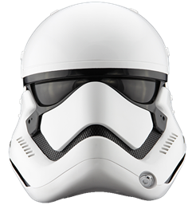
Game completion
To complete the game , find clues on what to do next. (talk to the npcs that are in the locations)
Once you get on the empire’s spaceship you will have to defeat low level enemies to find Leia.
To finally beat the game you will have to defeat the final enemy which is Darth Vader.
Notes:
k

Slide 23
Problems we faced
Using Git
Timer function
Adding colour to the text
Music
Notes:
k

Slide 24
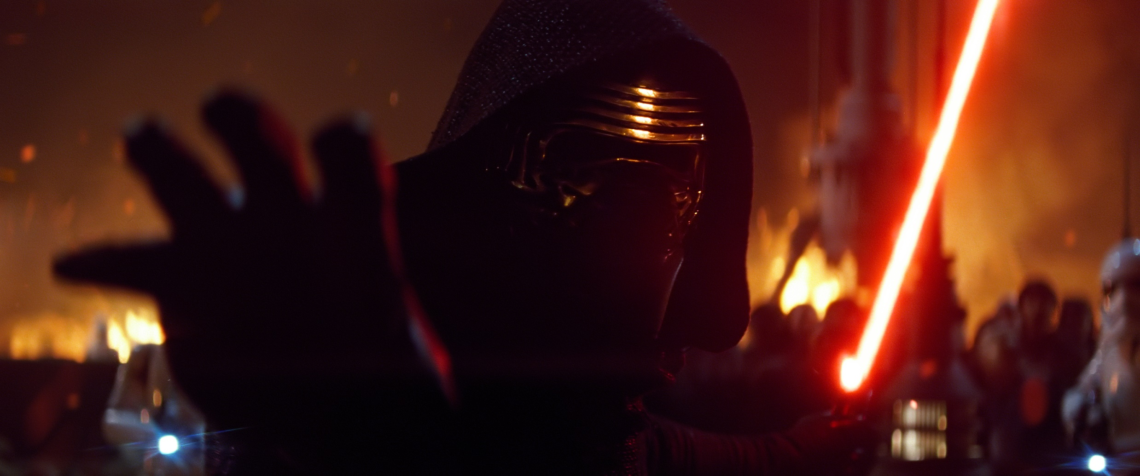
Thank you for watching

Slide 25
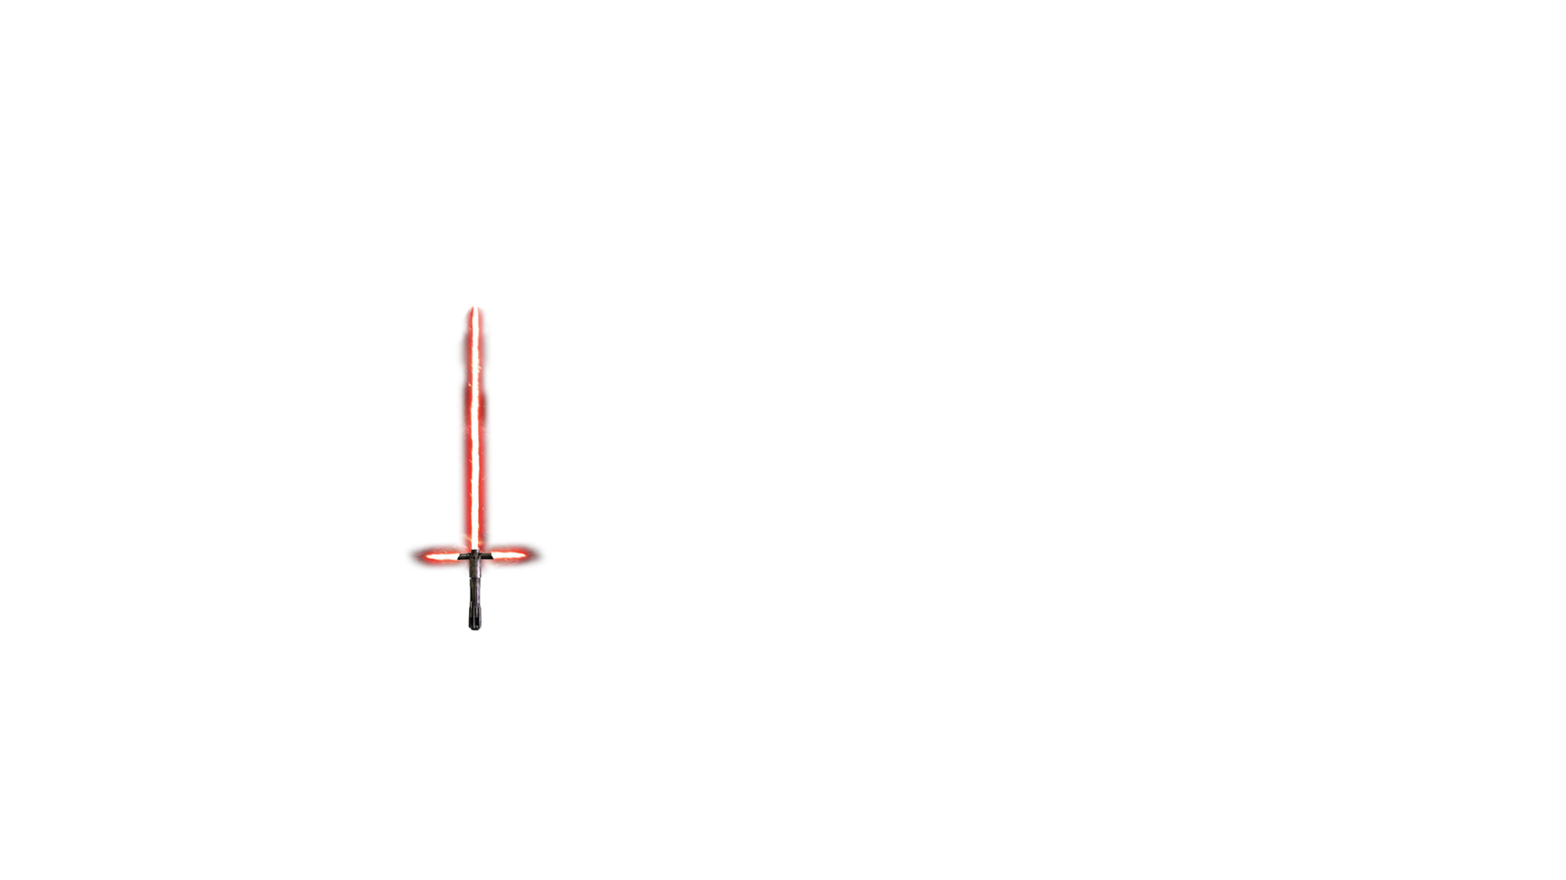
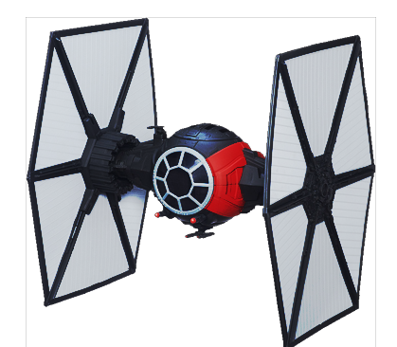

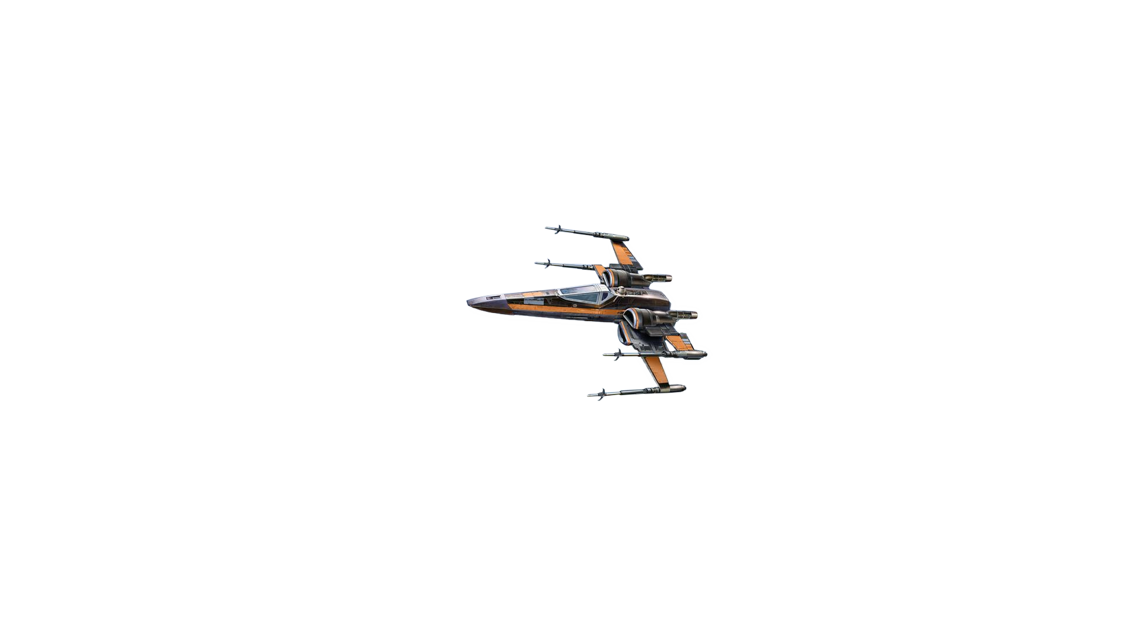
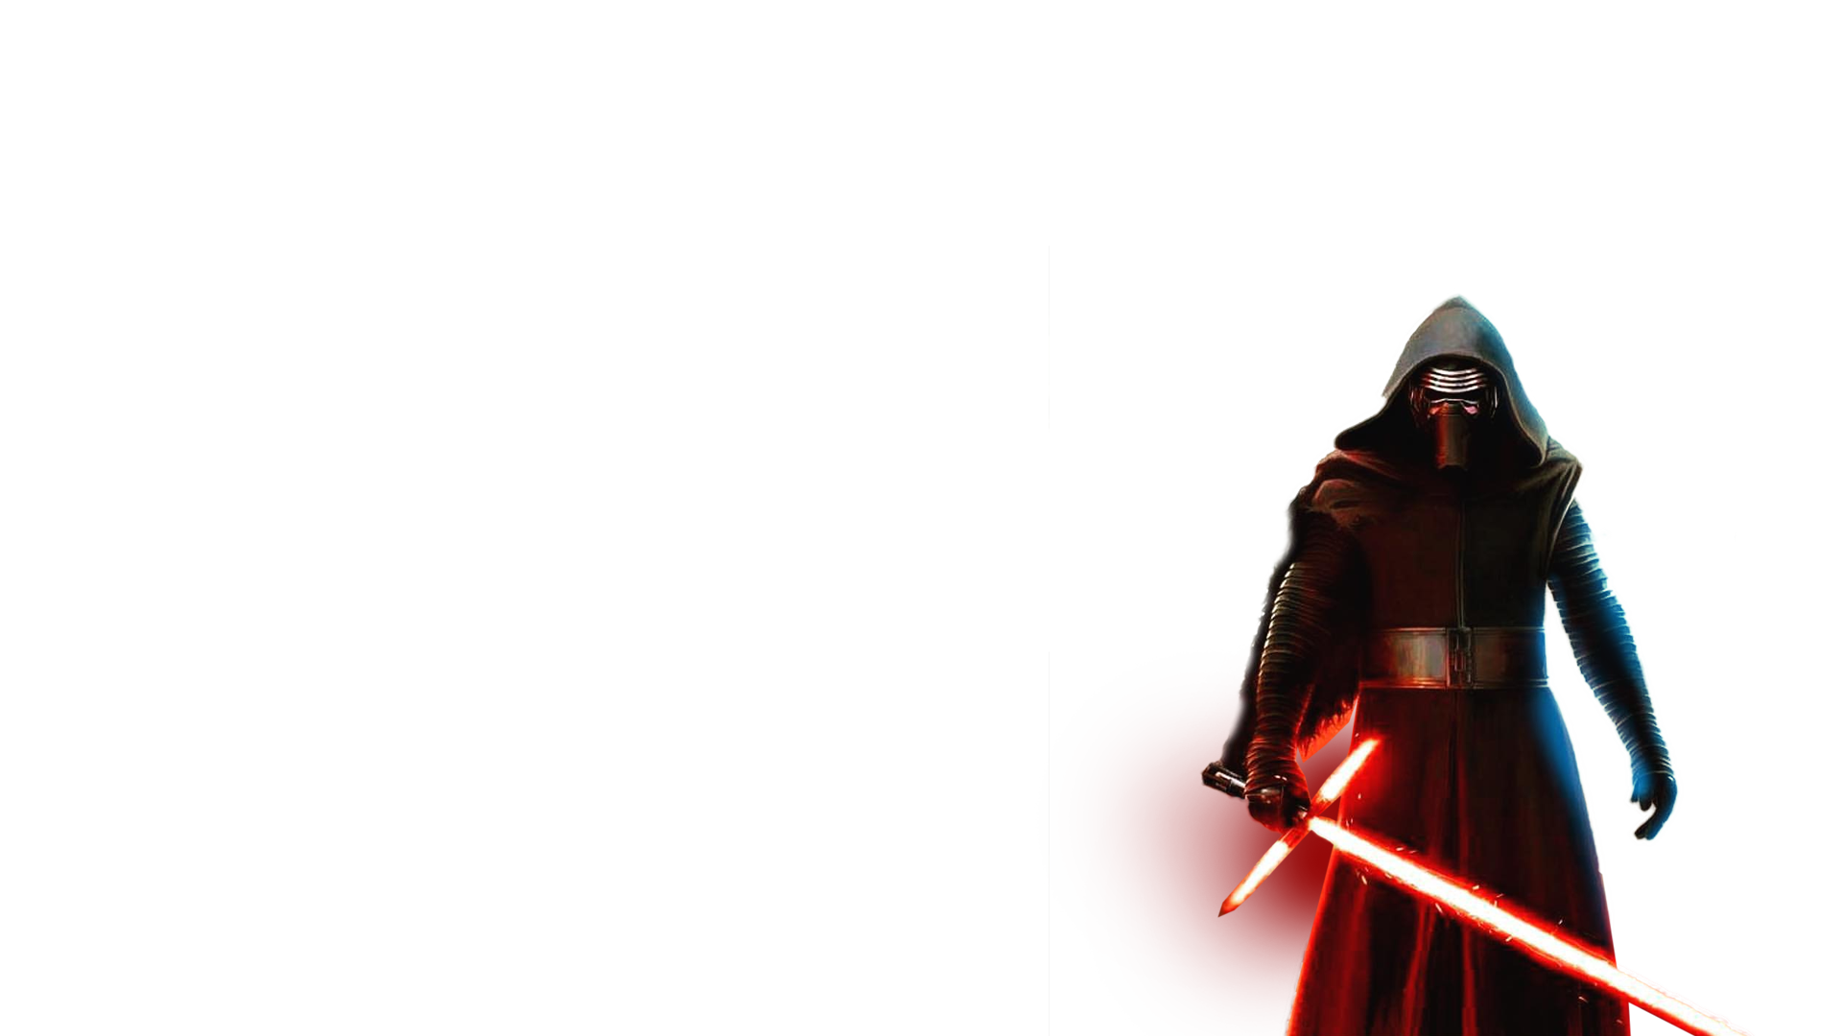

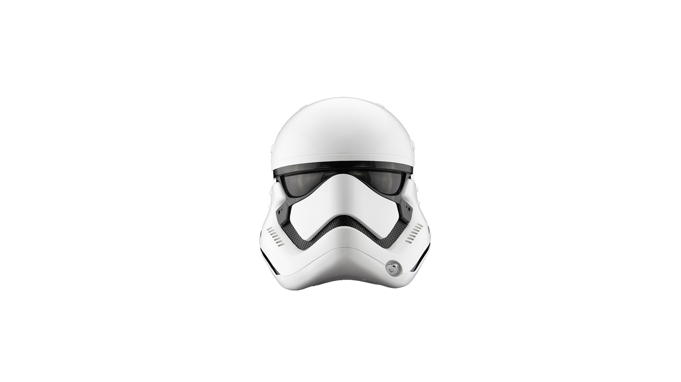
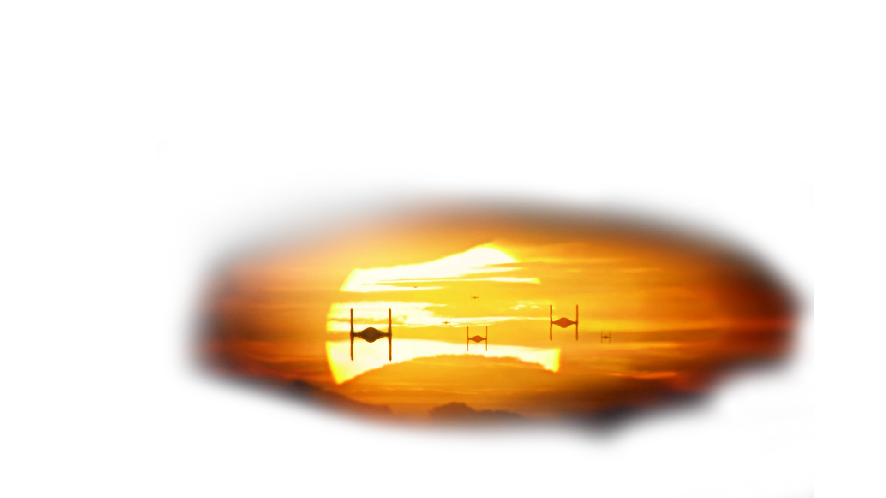
Misc. Art Elements

